Slide 1
Arto’s Step 2 kladd
Mixat, upp och ner. Fram och tillbaka.

Slide 2
GENERIC TEST CASE
CONTAINER
TEST CASES
A generic test case, a container for more
specific test cases. A generic test case can
be used on any truck. (With that functionality)
Multiple test cases can be held within that
container. Different descriptions, expected result
etc depending on product class, software release etc.
TEST CASE V1.3

Slide 3
GENERIC CONNECTIONS
TRUCK FUNCTION AREA
POWERTRAIN
TRUCK FUNCTION
IDLE ADJUST
GENERIC CONTAINER ID#023
Adjust idle speed
TEST CASE v1.0
PC 24-HDV
Depress brake pedal, and keep brake pedal depressed. Hold resume button for two seconds.
Container should be connected to a child in the hierarchy / structure . And hierarchy should be possible to change. Unlimited depth.
TEST CASE v1.1
PC 23-HDV, D3-HDV
Go into menu in DID and select adjust idle speed. Idle speed is expected to drop down to lowest possible setting.
TEST CASE v1.2
PC XX-MDV
Engage and disengage the cruise control three times within two seconds.

Slide 4
TEST CASE
TEST CASE CONTENT
ID
LOCATION
Possibility to connect a test case to one or several areas. GPS. When entering area test case should be displayed.
PARENT ID
DESCRIPTION
EXPECTED RESULT
LINK
Possibility to connect a test case to one or several test cases. When a test case with a link is displayed, the test cases linked with it should be displayed as ”relevant”.
VARIANT FILTER
PRODUCT CLASS FILTER
VISIBLE
TAGS
TOOLS NEEDED
IMAGES
If another column is needed in the database in the future, it should be possible to add this without breaking the code.
REPETITION
LAST CHANGE
TEST CASE NOTES

Slide 5
SEQUENCE
SEQUENCES
ID
NAME
SEQUENCE
TYPE
PRIVATE
LAST USAGE
TEST CASE 1
LAST CHANGE
TEST CASE 1
TEST CASE 1
TEST CASES
TEST CASE 1
STRICT
A sequence contains test cases. A sequence can belong to different groups. (Default / Dev / etc). And a sequence can be private, only visible to you. When doing development tests, before they are ready etc.
There should be a possibility for a sequence to be strict, driver is only able to follow the list exactly as it is without sorting or searching.

Slide 6
ROUTINE
ROUTINE
ID
NAME
DAILY INSPECTION
Make a daily inspection of the vehicle, check the following things.
Fluids
Tires
Lights
PROTOCOL
DESCRIPTION
LAST USAGE
LAST CHANGE
OVERNIGHT STAY
Sleep in the cab. Evaluate cab heater, curtains, living enviroment.
VERSION
REPEAT EVERY
A routine is an activity you do once, or periodically (daily/weekly etc). A routine can contain a protocol. A list of things you have to check off. The routine also contains a description.
The result of a routine during a test is an acknowledgement that the routine is done, and the protocol if it’s part of the routine, and comments from the driver.

Slide 7
PROCEDURE
PROCEDURE
ID
PROCEDURE
NAME
ROUTINE
SEQUENCE 1
SEQUENCE 2
ROUTINE
SEQUENCE 2
SEQUENCE 3
ROUTINE
A procedure is a container for sequences and routines. A list where you place sequences and routines in the order you want them. Also the ability to add repeating routines, performed without connection to the order. Ex. Daily inspection

Slide 8
ADMIN
Manage sub-groups
Manage users
Manage roles
Manage rights
Manage structure
Create / Edit
Create / Edit
Create / Edit
Delete
Delete
Delete
TEST ADMIN
Manage default sequences
Manage default routines
Manage TAGS
Manage TOOLS
Manage acronym translations
Create / Edit
Create / Edit
Create / Edit
Create / Edit
Create / Edit
Delete
Delete
Delete
Delete
Delete
PRODUCT CLASS
GJX / CKX ?

Slide 9
ADMIN / Manage sub-groups
/PVT/
Add sub-groups
Ex.
/PVT AGO
/PVT BLR
/PVT CUR
/PVT GOT
/PVT GSO
/PVT LYS
And assign users to that sub-group.
For example if a driver is assigned to /PVT/PVT GOT only tests created for PVT GOT will be showed and selectable.
Also used for default locations and views.

Slide 10
ADMIN / Manage users
Add access to users and assign roles / rights
Add VCN id and assign role / rights / and group belonging.
VCN id ...
Displayed name ...
Role ...
Add extra rights ...
Group ...
ADD
VCN Name Role Group Last login
T0C1836 Johan Jacobsson Test leader PVT GOT 2016-02-22 EDIT / DELETE
T0C1836 Johan Jacobsson Test leader PVT GOT 2016-02-22 EDIT / DELETE
T0C1836 Johan Jacobsson Test leader PVT GOT 2016-02-22 EDIT / DELETE

Slide 11
ADMIN / Manage roles
Create roles with different rights
Role name ...
Add right ...
ADD
TEST LEADER
Test Manager access
Driver Interface access
Refiner access
Create sequence
Create / follow / view tests
DRIVER
Driver Interface access

Slide 12
ADMIN / Manage structure
Add / Edit / Delete nodes in tree. The structure where test cases can be connected to leaf nodes....
ROOT
NODE
NODE
L
L

Slide 13
TEST ADMIN / Manage TAGS
Create TAGS
TAG name...
Description ...
ADD
TAG Description
DRIVING Vehicle in motion
VM PARKED Vehicle mode Parked
VM RUNNING Vehicle mode Running
HILLY Hilly terrain
STANDSTILL Vehicle standing still, parked
EDIT / DELETE
EDIT / DELETE EDIT / DELETE
EDIT / DELETE
EDIT / DELETE EDIT / DELETE

Slide 14
TEST ADMIN / Manage TOOLS
Create TOOLS needed in test cases etc.
Something more, serial / id numbers? General to track equipment and tools?
TOOL name...
Description ...
ADD
TOOL Description
Voltmeter Voltmeter
WIF Brake out Water in fuel brake out harness
USB with music USB stick with mp3/mp4/wma
Android phone Phone with android
Dummy key Key that’s dumb
EDIT / DELETE
EDIT / DELETE EDIT / DELETE
EDIT / DELETE
EDIT / DELETE EDIT / DELETE

Slide 15
TEST ADMIN / Acronym translation
Create acronym translations
If you use an acronym in a test case there will be an explanation below. Possible to get this from another DB?
Acronym...
Word / phrase...
ADD
Acronym Description
ACC Adaptive Cruise Control
CC Cruise Control
FCW Forward Collision Warning
LCS Lane Change Support
WTF What The Fuck
EDIT / DELETE
EDIT / DELETE EDIT / DELETE
EDIT / DELETE
EDIT / DELETE EDIT / DELETE
Example test case viewed to driver:
Description:
Activate ACC and change distance to target.
* ACC = Adaptive Cruise Control

Slide 16








PVT TEST MANAGER Editor Arto Mattila
List av all NOK from ALL sites in the lates 14 days
Status (graph) on FH-XXXX
Test case change log
etc
ONGOING TESTS : SITE GOT
FH-1824 PVT Total w1607 [ 34% ]
FH-1407 PVT Dev P2967 w1606 [ 4% ]
FH-1381 PVT Dev I-See E QJ w1605 [ 35% ]
OVERVIEW
TEST CREATOR
TASKHANDLER
12
TASKS
SEQUENCE HANDLER
Take a look
TEST CASE MANAGER
ADD ANOTHER FAVORITE VIEW
STATISTICS
SETTINGS
HELP & INFO

Slide 17



PVT TEST MANAGER Test leader Johan J
CREATE TEST
PROCEDURE: PVT TOTAL (Default)
OVERVIEW
SETUP:
PROCEDURE:
OPEN
Test name ...
START OF TEST
TEST CREATOR
Test leader
READ OUT FAULT CODES
SAVE
TEST OBJECT:
CHECK
Vehicle (Automatically from GHOST?)
GO / NO GO
ADD SEQUENCE
SEQUENCE HANDLER
BASE LOOP 1
Software (Automatically from GHOST?)
BASE LOOP 2
WBS (Automatically from GHOST?)
READ OUT FAULT CODES
TEST CASE MANAGER
ADD ROUTINE
EQUIPMENT:
MINI EXPEDITION
M-logger
ADD
TOTAL
Trailer (ID)
Container (ID)
READ OUT FAULT CODES
END OF TEST
STATISTICS
PERSONNEL:
Peter Andersson
ADD
SETTINGS
Driver team GOT
RECCURING ROUTINES:
DAILY INSPECTION
SAVE
SAVE LOG FILES
HELP & INFO

Slide 18
PVT TEST MANAGER Editor Arto Mattila
Search test case
OVERVIEW
Live search results ...
TEST CREATOR
TC
SEQUENCE HANDLER
TEST CASE MANAGER
STATISTICS
SETTINGS
HELP & INFO

Slide 19




PVT TEST MANAGER Editor Arto Mattila
Create / Edit test case
OVERVIEW
LINK
CONNECT TO PARENT
ADD IMAGE
CATEGORY
TEST CREATOR
Description...
PRIVATE
DEV
PRODUCTIO N
REPETITION
SEQUENCE HANDLER
LOCATION
Expected result...
TEST CASE MANAGER
TOOLS NEEDED
Variantfilter...
PRODUCT CLASS FILTER
TAGS
04-TLV
28-HDV
29-HDV
DAYLIGHT
DRIVING
STATISTICS
23-HDV
24-HDV
D3-HDV
VM RUNNING
HILLY
D4-MDV
63-HDV
06-MDV
USED IN SEQUENCE
SETTINGS
A1-MDV
A2-MHDV
A3-MDV
TOTAL
P1234 DEV
A4-MHDV
SAVE
HELP & INFO

Slide 20
Safety, Usability, Acceptance, Trust, Fun, Expectations,Usage behavior, Knowledge, Distraction
Light, dark, noise, location, temperature
Adaptivity, customization, flexibility, consistency, personalization

Slide 21

PVT DRIVER INTERFACE
Username...
Pin code...
7
8
9
4
5
6
1
2
3
LOGIN

Slide 22
PVT DRIVER INTERFACE Tester Arto Mattila
ONGOING PVT TESTS AT SITE GOT
FH-1824 Total w1623 IB
44%
DONE
LOAD
FH-1407 SEM w1607
23%
DONE
CURRENTLY CHECKED OUT BY:
THE HOOK
FH-1381 SEM w1607
5%
DONE
CURRENTLY LOCKED BY
TEST LEADER

Slide 23




PVT DRIVER INTERFACE FH-1824 Total w1623 IB Tester Arto Mattila
MESSAGES
TEST STATUS
Don’t remove driver card or change it to rest, tachograph test running over time. Check ongoing test cases.
KALLE ANKA| 2016-08-23 14:23
ROUTINE | START OF TEST
SEQUENCE | CHECK
I activated the engine heater with a timer, check that it starts by 07:00
THE HOOK | 2016-08-23 14:23
ROUTINE | READ OUT FAULTCODES
SEQUENCE | BASE
Could you please take a picture of that problem you found yesterday.
TESTLEADER| 2016-08-23 12:00
SEQUENCE | BASE LOOP 2 | [20%]
ROUTINE | READ OUT FAULTCODES
STATS
ROUTINE | MINI EXPEDITION
OK 230
NOK 22
REM 300
SEQUENCE | TOTAL
ROUTINE | END OF TEST
44% DONE
OVERVIEW
TEST CODE
AUTO MODE
FAULT REPORT
SETTINGS
CAMERA
CHECK IN

Slide 24
PVT DRIVER INTERFACE FH-1824 Total w1623 IB Tester Arto Mattila
Live search results...
BLANKS
ALL
OK
NOK
FUNCTION AREA
FUNCTION
TAGS
VERSION: 023_1.0
POWERTRAIN / IDLE ADJUST / ADJUST IDLE SPEED
DESCRIPTION:
EXPECTED RESULT:
Depress brake pedal, and keep brake pedal depressed. Hold resume button for two seconds.
The new idle speed should be saved.
OK
NOK
NT
TAGS:
STANDSTILL
RUNNING
ANTITHEFT / DOOR LOCK CONTROL / CENTRAL DOOR LOCK WITH KEY
VERSION: 426_1.1
DESCRIPTION:
EXPECTED RESULT:
Lock vehicle with key
Unlock vehicle
Repeat unlock
Both doors should lock
Driver door should unlock
Passanger door should unlock
OK
NOK
NT
TAGS:
FAULT REPORT
SETTINGS
CHECK IN
OVERVIEW
STANDSTILL
RUNNING
TEST CODE
AUTO MODE
CAMERA

Slide 25






PVT DRIVER INTERFACE FH-1824 Total w1623 IB Tester Arto Mattila
SORT BY TAGS:
STANDSTILL
RUNNING
ADD
POWERTRAIN / IDLE ADJUST / ADJUST IDLE SPEED
SELECT ON LOCATION
VERSION: 023_1.0
DESCRIPTION
Depress brake pedal, and keep brake pedal depressed. Hold resume button for two seconds.
WAIT 10 MINUTES
VIEW IMAGE
EXPECTED RESULT
BOOKMARK
The new idle speed should be saved.
READ IT TO ME
OK
NOK
NT
SKIP
REPORT TC FAULT
OVERVIEW
TEST CODE
AUTO MODE
FAULT REPORT
SETTINGS
CAMERA
CHECK IN

Slide 26
LOG FILES /

Slide 27


CENTRAL SERVER
Today there’s a lot of log files during PVT tests, and with slow connections and having to upload everything to a central server in Gothenburg takes time. Every location should have their own storage. As a first line where everything gets sorted, and then just sync logs that are going to be used in some way to the central server. And if off location, it should be possible to process and sort logs on your own computer / external drive.

Slide 28










PROTUS
FAULT REPORT
TEST LEADER
VIEW, SORT, USE
STATISTICS, HISTORY
TEST MANAGER
LOG DATA
TEST DATABASE
CENTRAL SERVER
REFINER
DRIVER INTERFACE
LOCAL SERVER / HDD
LOG DATA

Slide 29


DATA REFINER Test leader Johan J
Unhandled events
FH-1407
FH-1381
ADD
OVERVIEW
FH-1407
MEA_0415 / 01 2016-01-14 23:15:05 – 2016-01-14 23:15:35 4 TEST: FH-1407 SEM w1607
MEA_0415 / 02 2016-01-14 23:16:15 – 2016-01-14 23:16:45 4 TEST: FH-1407 SEM w1607
VIEW
MEA_0416 / 01 2016-01-14 23:30:10 – 2016-01-14 23:30:40 TEST: FH-1407 SEM w1607
FH-1381
MEA_0415 / 01 2016-01-14 23:15:05 – 2016-01-14 23:15:35 1
LOGS
MEA_0415 / 02 2016-01-14 23:16:15 – 2016-01-14 23:16:45 1
MEA_0416 / 01 2016-01-15 23:30:10 – 2016-01-14 23:30:40
MEA_0416 / 02 2016-01-15 14:15:05 – 2016-01-14 14:15:35
MEA_0416 / 03 2016-01-15 23:16:15 – 2016-01-14 23:16:45
MEA_1416 / 01 2016-02-01 15:30:10 – 2016-01-14 15:30:40 2
LOCAL SERVER CHANGES (Site GOT)
New logger data detected from vehicle FM-739 (Not connected to test)
New logger data detected from vehicle FH-1900 (Connected to: PVT Dev Cluster P1234, TL: Therese)
SETTINGS
HELP & INFO

Slide 30
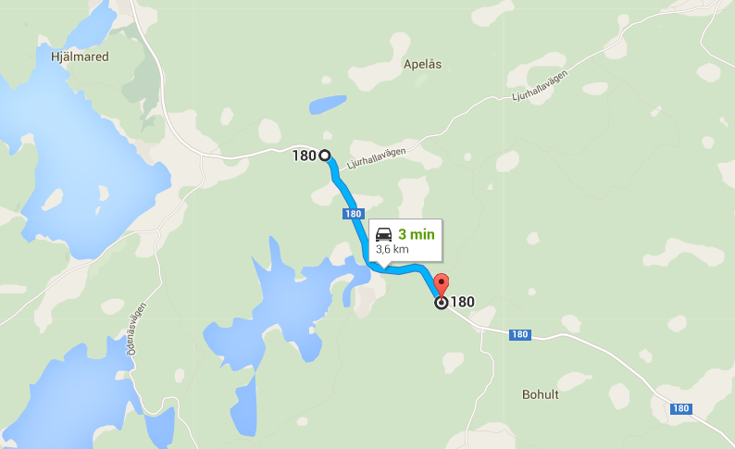
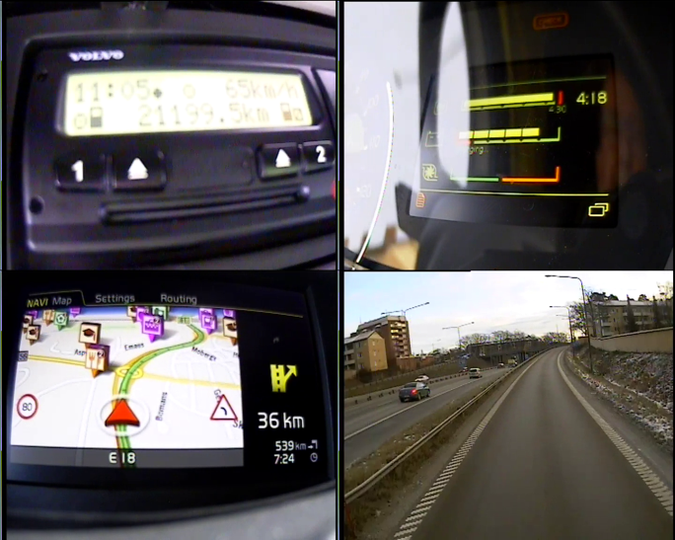

DATA REFINER Test leader Johan J
View
OVERVIEW
FH-1407 / MEA_0415 / 01 2016-01-14 23:15:05 – 2016-01-14 23:15:35
VIEW
ALL
VIEW
V 1
V 2
V 3
V 4
LOGS
CANalyzer
Protus ID ...
INCLUDE:
Comment ...
AUDIO
If protus id is entered, the log will be uploaded to central server and be attached as a link in protus report automatically.
If you don’t enter protus id the log is saved and stored on local server for later use.
VIDEO [CAM 1]
VIDEO [CAM 2]
SETTINGS
VIDEO [CAM 3]
NO VOICE
NAVI
ADD TAG
VIDEO [CAM 4]
2X2 GRID INCL AUD
DISCARD
Sorting category...
SAVE
HELP & INFO

Slide 31
DATA REFINER Test leader Johan J
LOGS (PVT Site GOT)
OVERVIEW
TEST: FH-1407 SEM w1607
TEST: FH-1824 PVT Total W23
Total events: 424 Unhandled events: 3
46 events connected to 14 protus reports
Total events: 89 Unhandled events: 6
15 events connected to 11 protus reports
VIEW
TEST: FH-1900 PVT Dev Cluster P1234
Total events: 5 Unhandled events: 5
0 events connected to 0 protus reports
LOGS
VEHICLE: FM-739
Total events: 20 Unhandled events: 320 0 events connected to 0 protus reports
SETTINGS
HELP & INFO

Slide 32
DATA REFINER Test leader Johan J
LOGS / FH-1407 SEM w1607
OVERVIEW
Unhandled events
MEA_0415 / 01 2016-01-14 23:15:05 – 2016-01-14 23:15:35 1
MEA_0415 / 02 2016-01-14 23:16:15 – 2016-01-14 23:16:45 1
VIEW
MEA_0416 / 01 2016-01-14 23:30:10 – 2016-01-14 23:30:40
Radio
MEA_0415 / 01 2016-01-14 23:15:05 – 2016-01-14 23:15:35 4 [L561612] [STATUS 21] [5p]
LOGS
MEA_0415 / 02 2016-01-14 23:16:15 – 2016-01-14 23:16:45 4
MEA_0416 / 01 2016-01-14 23:30:10 – 2016-01-14 23:30:40
Launcher Crash
MEA_0415 / 01 2016-01-14 23:15:05 – 2016-01-14 23:15:35 1 [L234556] [STATUS 21] [25p]
MEA_0415 / 02 2016-01-14 23:16:15 – 2016-01-14 23:16:45 1 [L234556] [STATUS 21] [25p]
MEA_0416 / 01 2016-01-15 23:30:10 – 2016-01-14 23:30:40
MEA_0416 / 02 2016-01-15 14:15:05 – 2016-01-14 14:15:35
MEA_0416 / 03 2016-01-15 23:16:15 – 2016-01-14 23:16:45
MEA_1416 / 01 2016-02-01 15:30:10 – 2016-01-14 15:30:40 2
I-SEE / No pre-speed
SELECTED EVENTS:
SETTINGS
ON MAP
CONNECT TO PROTUS
ON TIMELINE
STATS
HELP & INFO
CENTRAL SERVER LOCAL SERVER OWN HDD

Slide 33
DATA REFINER Test leader Johan J
TEST: FH-1407 SEM w1607
OVERVIEW
TIMELINE SELECTED EVENTS (Launcher Crash)
Radio
MEA_0415 / 01 2016-01-14 23:15:05 – 2016-01-14 23:15:35 4 [P: L561612] [STATUS 21]
MEA_0415 / 02 2016-01-14 23:16:15 – 2016-01-14 23:16:45 4
VIEW
MEA_0416 / 01 2016-01-14 23:30:10 – 2016-01-14 23:30:40
MEA_0415 E1
13:14
MEA_0415 E1
15:23
Launcher Crash
MEA_0415 / 01 2016-01-14 23:15:05 – 2016-01-14 23:15:35 1 [P: L234556] [STATUS 21]
LOGS
MEA_0415 / 02 2016-01-14 23:16:15 – 2016-01-14 23:16:45 1 [P: L234556] [STATUS 21]
MEA_0416 / 01 2016-01-15 23:30:10 – 2016-01-14 23:30:40
MEA_0416 / 02 2016-01-15 14:15:05 – 2016-01-14 14:15:35
14/1
15/1
MEA_0416 / 03 2016-01-15 23:16:15 – 2016-01-14 23:16:45
MEA_1416 / 01 2016-02-01 15:30:10 – 2016-01-14 15:30:40 2
System crash
I-See – No pre-speed
MEA_0415 E1
08:45
MEA_0415 E1
14:02
MEA_0415 E1
18:23
VIEW SELECTED EVENTS:
ON MAP
SETTINGS
TIMELINE
HELP & INFO
CENTRAL SERVER LOCAL SERVER OWN HDD

Slide 34
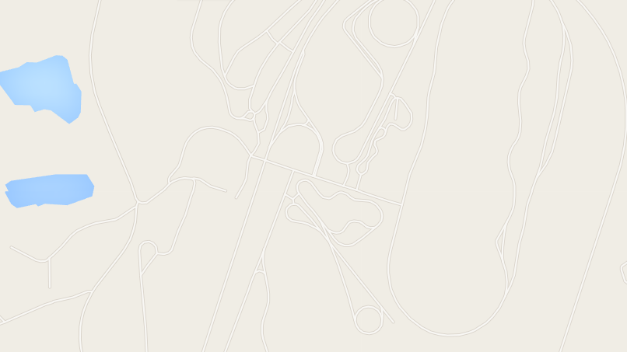
DATA REFINER Test leader Johan J
TEST: FH-1407 SEM w1607
OVERVIEW
MAP SELECTED EVENTS (Bad radio reception)
Radio
MEA_0415 / 01 2016-01-14 23:15:05 – 2016-01-14 23:15:35 4 [P: L561612] [STATUS 21]
MEA_0415 / 02 2016-01-14 23:16:15 – 2016-01-14 23:16:45 4
VIEW
MEA_0416 / 01 2016-01-14 23:30:10 – 2016-01-14 23:30:40
Launcher Crash
MEA_0415 / 01 2016-01-14 23:15:05 – 2016-01-14 23:15:35 1 [P: L234556] [STATUS 21]
LOGS
MEA_0415 / 02 2016-01-14 23:16:15 – 2016-01-14 23:16:45 1 [P: L234556] [STATUS 21]
MEA_0416 / 01 2016-01-15 23:30:10 – 2016-01-14 23:30:40
MEA_0416 / 02 2016-01-15 14:15:05 – 2016-01-14 14:15:35
MEA_0416 / 03 2016-01-15 23:16:15 – 2016-01-14 23:16:45
MEA_1416 / 01 2016-02-01 15:30:10 – 2016-01-14 15:30:40 2
System crash
I-See – No pre-speed
VIEW SELECTED EVENTS:
ON MAP
SETTINGS
TIMELINE
HELP & INFO
CENTRAL SERVER LOCAL SERVER OWN HDD

